Slide 1
Class Topic- Human Geography
Class- 2nd Sem(H)
Paper code 2016(HC)
Dr. P. K. Nath
10-05-2021

Slide 2
NATURE OF HUMAN GEOGRAPHY
Human Geography is the study of the interrelationships between human societies and environment, and how these vary spatially and temporally across and between locations.
human geography concentrates on the spatial organization and processes shaping the lives and activities of people, and their interactions with environment.

Slide 3
The nature of Human Geography can be understood by investigating the objectives and approaches of it.
The man-nature relationship has been interpreted and investigated in several ways.
Since post Darwinian era, there had been great differences among the geographers about the approaches to examine the man-environment relationship.

Slide 4
Approaches in Human Geography
Environmentalism or Determinism(Naturalisation of man)
Possibilism(humanisation of nature)
Neo-determinism(stop and go determinism)
Cultural or social determinism
Areal differentiation
Spatial organisation
Humanistic /welfare
Radical
Behaviouralism
Post Modernism
System analysis

Slide 5
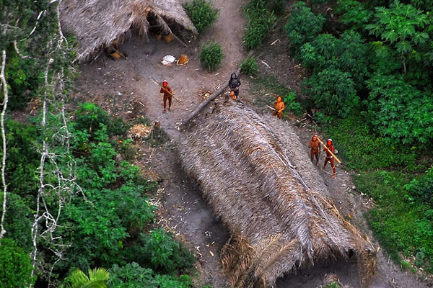
Naturalisation of Man(Bororo Tribe,Amazan)

Slide 6
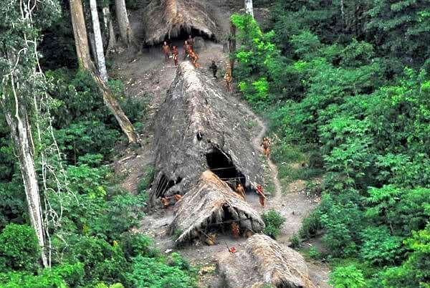
Naturalisation of Man(Sentinelese Tribe, Andaman islands)

Slide 7
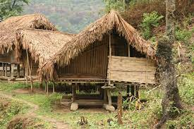

Slide 8
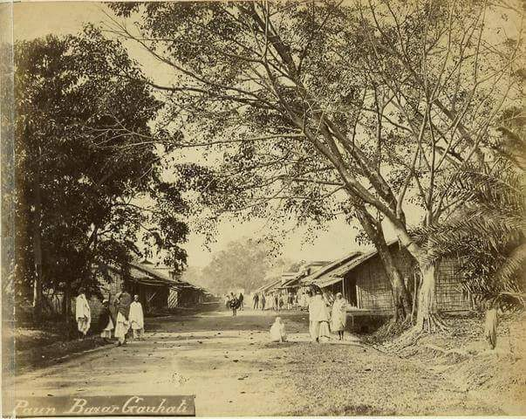

Slide 9


Slide 10


Slide 11
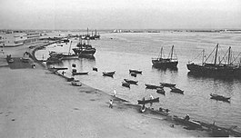
Dubai

Slide 12
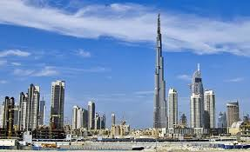

Slide 13
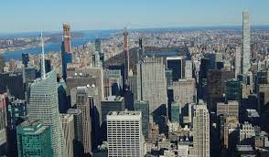
Humanisation of Nature,Newyork

Slide 14
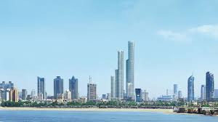
Humanisation of Nature, Mumbai

Slide 15
Though human geography has a very long history, it formally got increasing importance in the 18th and 19th centuries. The view that there is close relationship between man and his physical environment was also emphasized by the Greek and Roman scholars.

Slide 16
It received its modern credentials during the later part of the 18th century and the beginning of 19th century when Alexander von Humboldt and Carl Ritter stressed on the relationship between social groups and their natural environment.
F. Ratzel’s pioneer work “Anthropogeography” is considered as a landmark in the history of human geography. In this, Ratzel defined human geography as the “synthetic study of the relationship between human societies and the earth’s surface”. Evirnonmentalism was the approach adopted by F.Ratzel to interpret synthetic relationship between human societies and the earth’s surface

Slide 17
Environmentalism or determinism is a way of studying man- environment relationship that reflects a society of naturalization of man.
This a classical approach which was supported by father of modern human geography, F.Ratzel, E.Huntington, E.C.Semple to study those societies that were closely influenced by factors of environment.
This approach believes that all history, culture, life style, stage of development of society, are exclusively governed by physical factors.

Slide 18
The French geographer Vidal de la Blache wrote a classic entitled “Principles de Geography Humaine” (published in Paris after his death in 1922 and translated into English in 1926). He introduced Possibilism approach in Human geography.

Slide 19
The french historian Lucian Febvre was the first to use the word ‘possibilism”
He wrote,” there are no necessities, but everywhere possibilities; and man as master of these possibilities is the judge of their use”
This approach states that the people are not just puppets of natural environment. Natural environment presents options, number of which increases as the knowledge and technology of a cultural group develop.
This approach considers man as an active agent and explains how he makes changes and create a cultural landscape

Slide 20
In the first part of 20th century, Griffith Taylor formulated his ‘Stop-and-Go Determinism’or Neo deterninism approach stating that man is able to accelerate, slow or stop the progress of a country/community’s development but not the direction of progress set by environment. He developed this concept in 1920 by studying agricultural settlement in Australia.

Slide 21
The cultural or social determinism emphasizes the human element: our thoughts determine our acts and our acts determine the previous nature of the world”(james,1932)
since human interest, desires, prejudices and values vary across space, there is consequent variation in the cultural landscape and levels of development. The modification of environment largely depends on our perception, ideas and decision making processes. This philosophy is advocated by American scholars.(Edward Ullman)

Slide 22
for example, a country is richly endowed from hunters point of view may appear poor to cultivators. Social determinism does not adequately assess the environmental factors, therefore many criticized it.

Slide 23
1930s through the inter war period Areal differentiation entered as the way of study in Human geography. The focus was on identifying the uniqueness of any region and understanding how and why it was different from others. Hartshorne introduced

Slide 24
Late 1950’s to late 1960’s spatial organisation or quantitative techniques was the approach of human geography. It is marked by the use of computers and sophisticated statistical tools. Laws of physics were often applied to human phenomena(spatial interaction) with analysis of map
This phase was called the quantitative revolution. The main objective was to identify mappable patterns for different human activities.
Spatial organisation views why and how things are arranged over space. It’s a pattern and process study. Its components are point,line&area pattern

Slide 25
After 1970
Welfare or humanistic approach in human geography was mainly concerned with the different aspects of social well-being of the people. These included aspects such as housing, health and education.
Radical approach employed Marxian theory to explain the basic cause of poverty, deprivation and social inequality. Contemporary social problems were relatedto the development of capitalism.

Slide 26
Behavioural approach laid great emphasis on lived experience and also on the perception of space by social categories based on ethnicity, race and religion, etc.
In 1990’s post modernism approach questions the earlier generalisations and theories and emphasises the local context.

Slide 27
Thus over the last 50 years the subject geography has been enriching with the development of its nature and philosophies. In contemporary geography, It has been seen that the three schools – Behaviouralism, positivism and structuralism have come to the fore.
The remarkable character (nature) of present geography-
Recognition to Individual
Interdisciplinary Approach
System Analysis

Slide 28
It is a fact that with increase of knowledge, objectives and approaches of a subject, it starts expanding and thus nature of the subject changed. If the subject is related to man or society, various philosophical views are included within it. In contemporary human geography, these c characteristics are visible and the subject geography has gained its desired tempo through these dynamisms.

Slide 29
Since, with the progress of time the interaction between man and environment has turned a complex pattern. Therefore, new approach like system analysis has come into being. Thus, today the nature of Human geography has assumed a dynamic character over long period of time.

Slide 30
With respect to methods, human geography uses the full sweep of quantitative and qualitative methods from across the social sciences and humanities, mindful of using them to provide a thorough geographic analysis. It also places emphasis on fieldwork and mapping, and has made a number of contributions to developing new methods and techniques, notably in the areas of spatial analysis, spatial statistics, remote sensing and GIS Science.

Slide 31
Together these approaches formed the basis for the growth of critical geography, and the introduction of postmodern and post-structural thinking into the discipline in the 1990s. These various developments did not fully replace the theoretical approaches developed in earlier periods, but rather led to further diversification of geographic thought. The result is that geographical thinking is presently highly pluralist in nature, with no one approach dominating.

Slide 32
Scope of Human Geography
Each of the physical, biological and social sciences has its own philosophy, methodology and scope.
Similarly, human geography, the major thrust is on the study of human societies in their symbiotic relation with the habitat or environment. Dealing with the spatial distribution of societies, human geography covers a very wide field. So its scope is enormous. Human geography is more allied with the social sciences and humanities, sharing their philosophical approaches and methods.

Slide 33
It embraces the study of human races; the growth, distribution and density of populations of the various parts of the world, their demographic attributes and migration patterns; and physical and cultural differences between human groups and economic activities.

Slide 34
Human geography also takes into account the mosaic of culture, language, religion, customs and traditions; types and patterns of rural settlements, the site, size, growth and functions of urban settlements, and the functional classification of towns.
The study of spatial distribution of economic activities, industries, trade, and modes of transportations and communications as influenced by the physical environment are also the important topics of human geography.

Slide 35
In brief, in human geography, we study the influence of physical environment on the economic activity, society, culture and religion of the people of a region.
The impact of man on environment is also a topic of growing importance in human geography.

Slide 36
Human geography being dynamic in nature over time it has been gradually expanding its areas of study. In the 1930s, the discipline of human geography was divided into ‘cultural geography’ and ‘economic geography’ and subsequently several new branches like political geography, social geography, urban geography etc. emerged out of human geography.

Slide 37
By the 1980s, human geography has widened to become an omnibus term, describing all those parts of geography which are not solely concerned either with the physical environment or with the technical issues dealt with under such geographical sub-fields as cartography.
These sub divisions of Human geography are shown in the following diagram

Slide 38
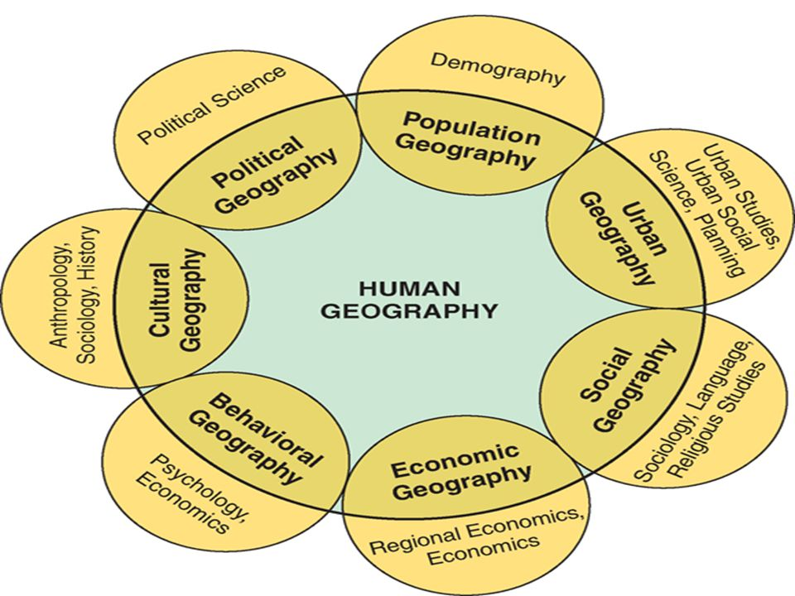
Major Sub-divisions of Human geography and its allied disciplines

Slide 39
Apart from above subdivisions, the new sub fields like medical geography and gender geography are gaining ground within the scope of present Human geography.
Human geography’s emphasis is on people: where they are, what they are like, how they interact over space and time, and what kinds of landscapes of human use they erect upon the natural landscapes Human geography’s content provides integration for all the social sciences, for it gives to those sciences the necessary spatial, temporal and systems viewpoint that they otherwise lack.

Slide 40
It helps us to understand the world we occupy and to appreciate the circumstances affecting peoples. It clarifies the contrasts in societies and cultures and in the human landscapes they have created in different regions of the earth.
Our study of human geography, therefore, can help make us better informed citizens, more able to understand the important issues facing our communities and our countries and better prepared to contribute to their solution

Slide 41
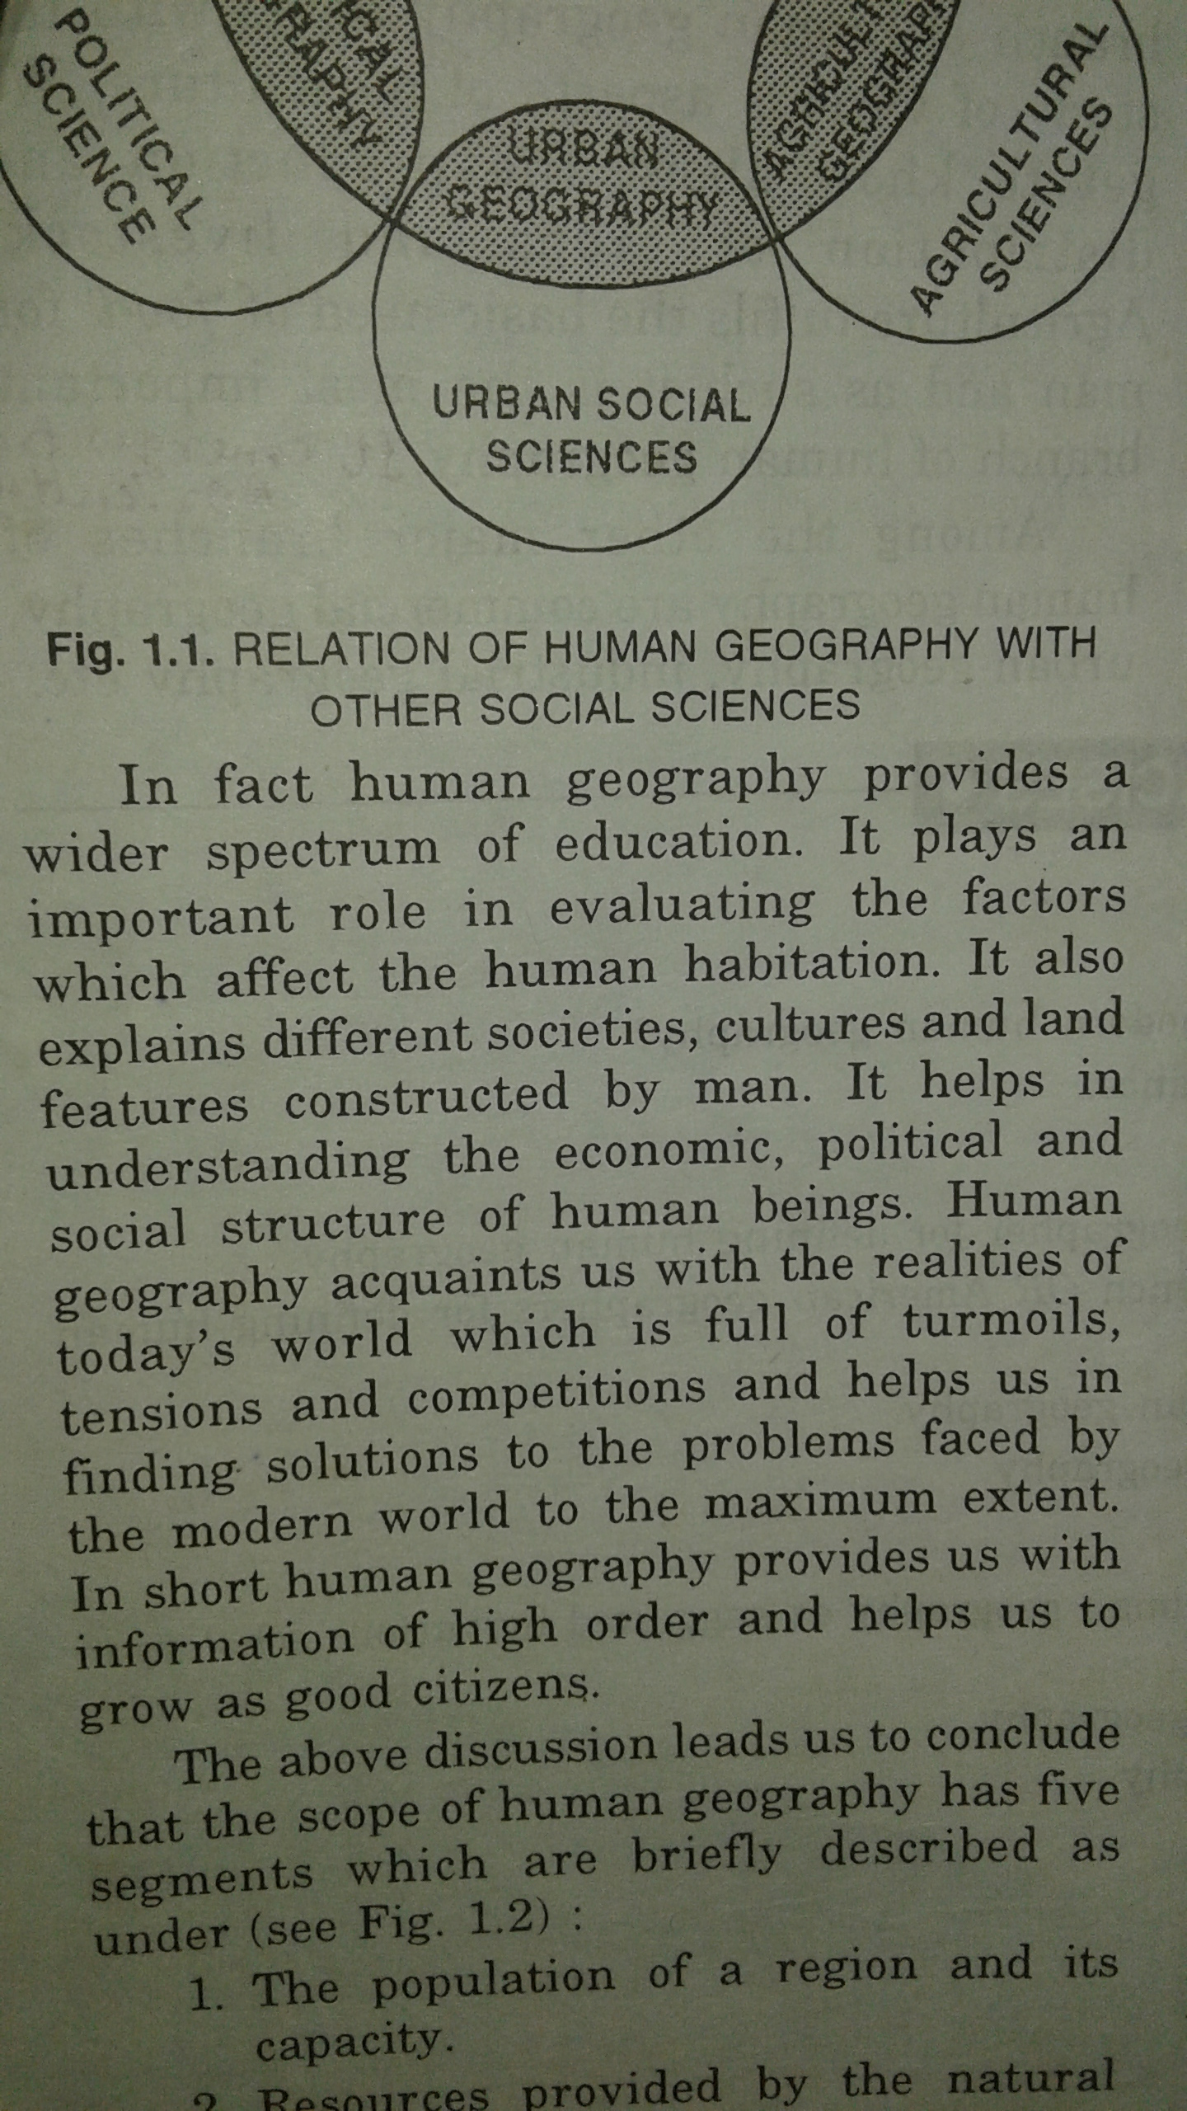

Slide 42
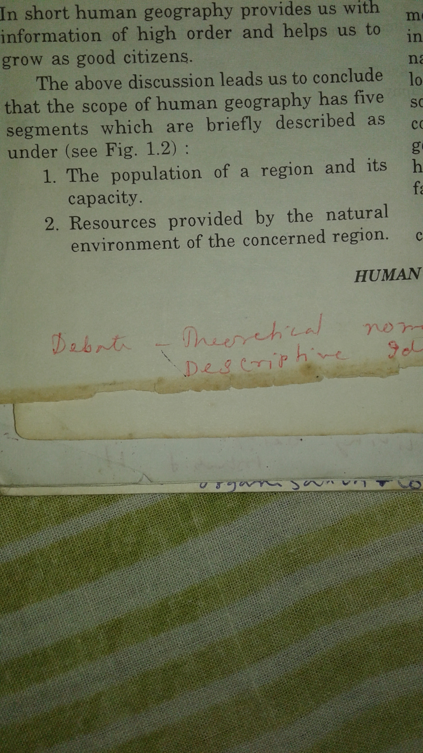

Slide 43
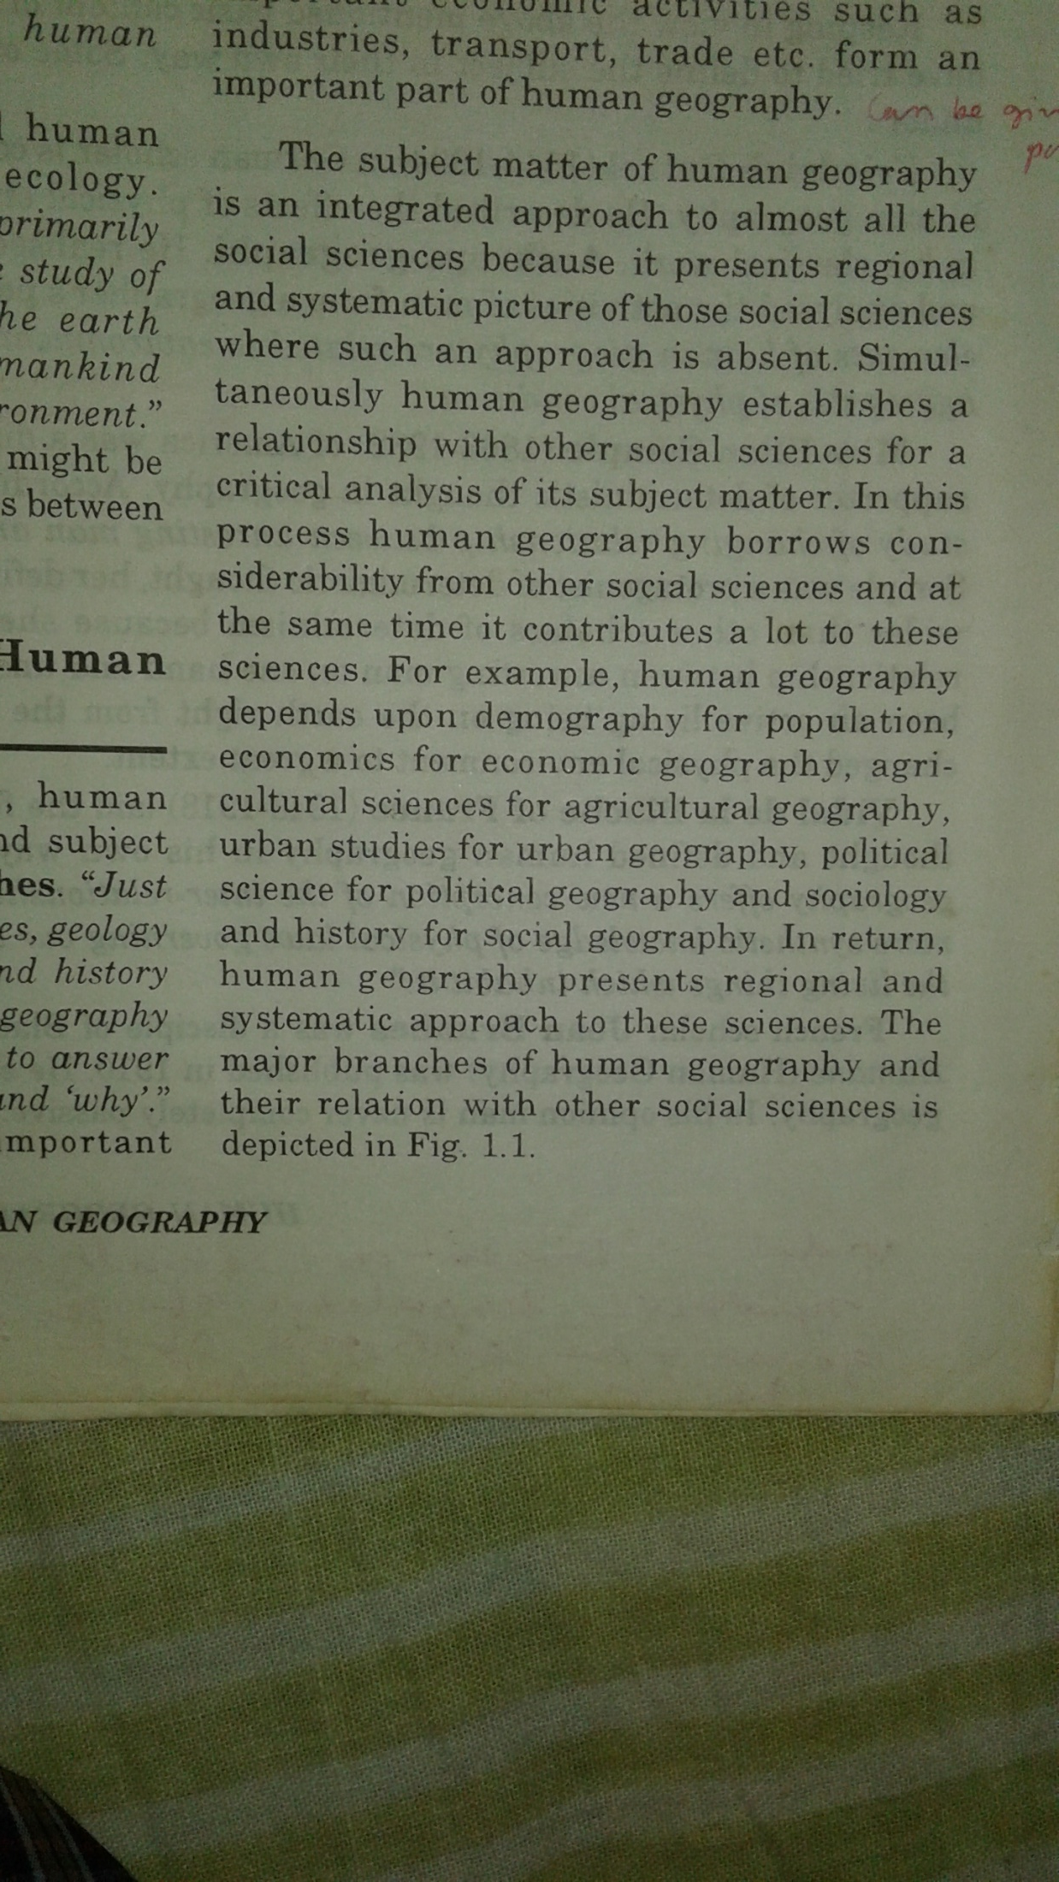

Slide 44
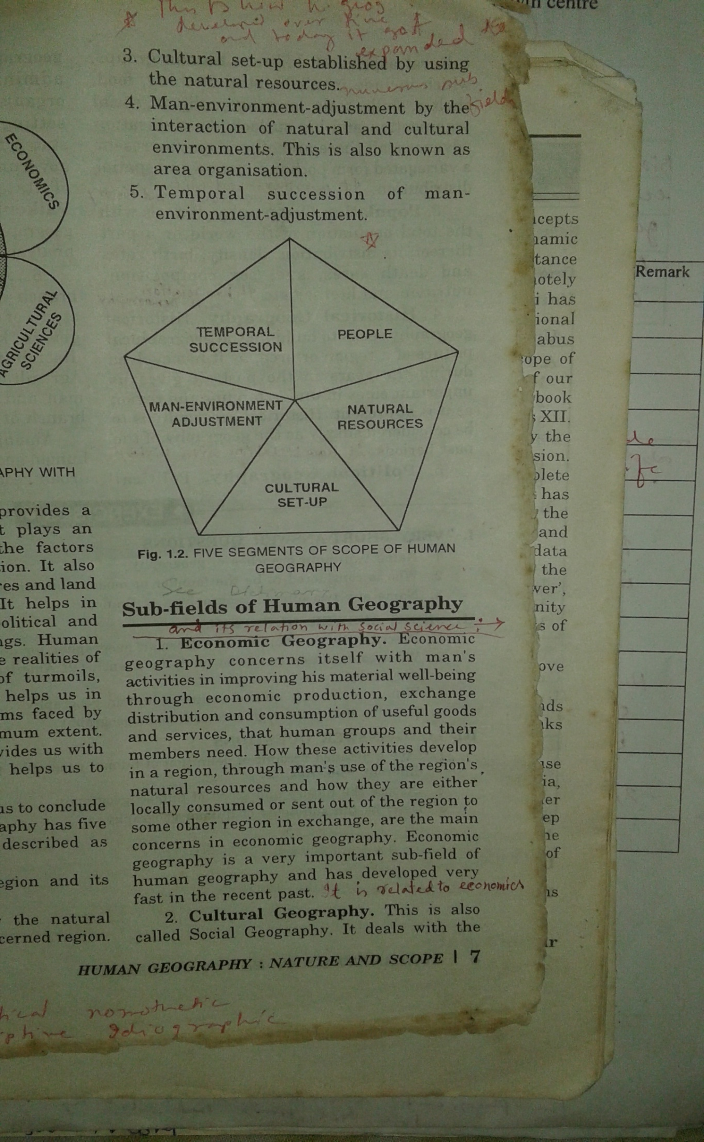

Slide 45
